Slide 1
Supplementary Figures

Slide 2
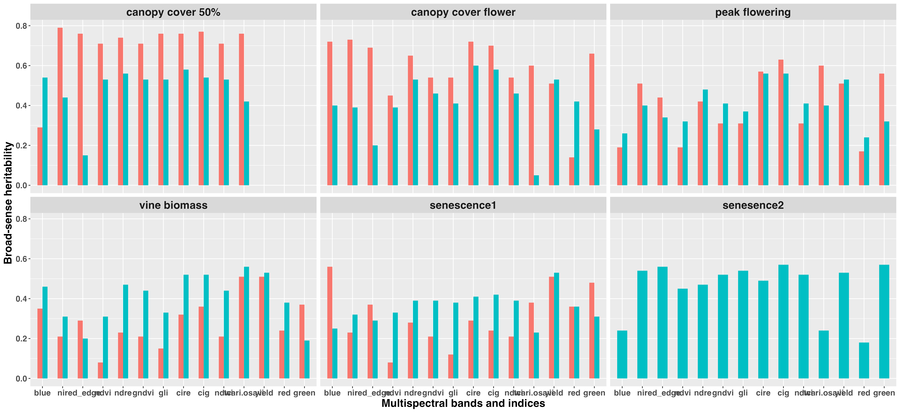

Figure S1. Broad-sense heritability of multispectral bands and indices within the chips market

Slide 3
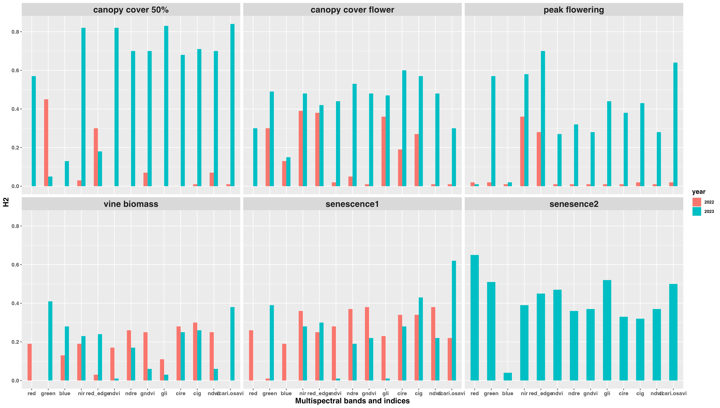
Figure S2. Broad-sense heritability of multispectral bands and indices within the fresh market

Slide 4
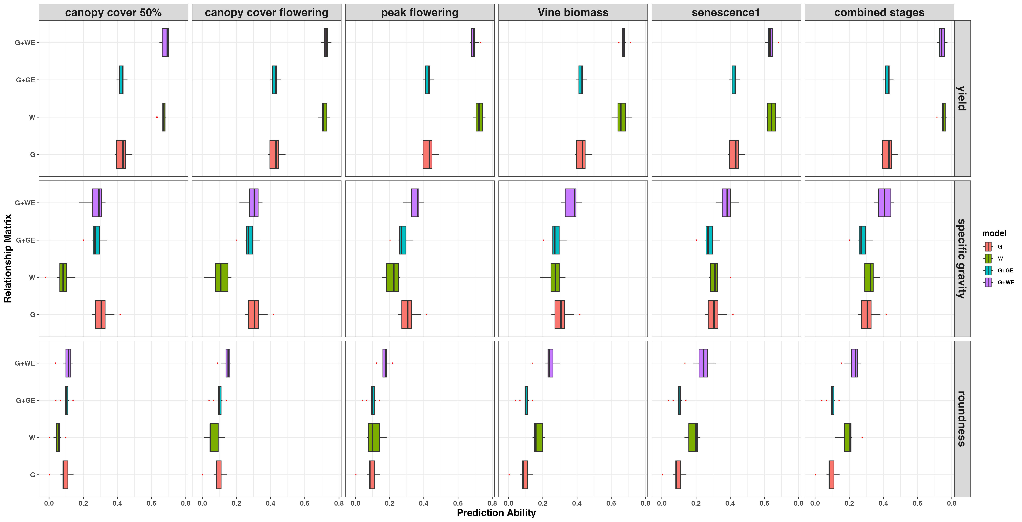
Figure S3. Prediction ability for traits within the chips market clones across growth stages using multispectral bands and Indices

Slide 5
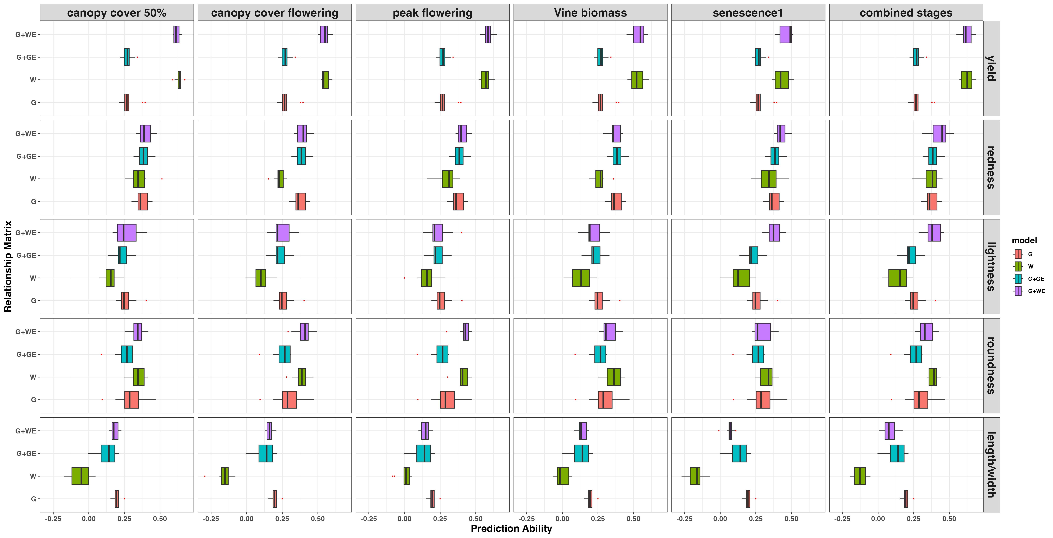
Figure S4. Prediction ability for traits within the fresh market clones across growth stages using multispectral bands and Indices

